Slide 1
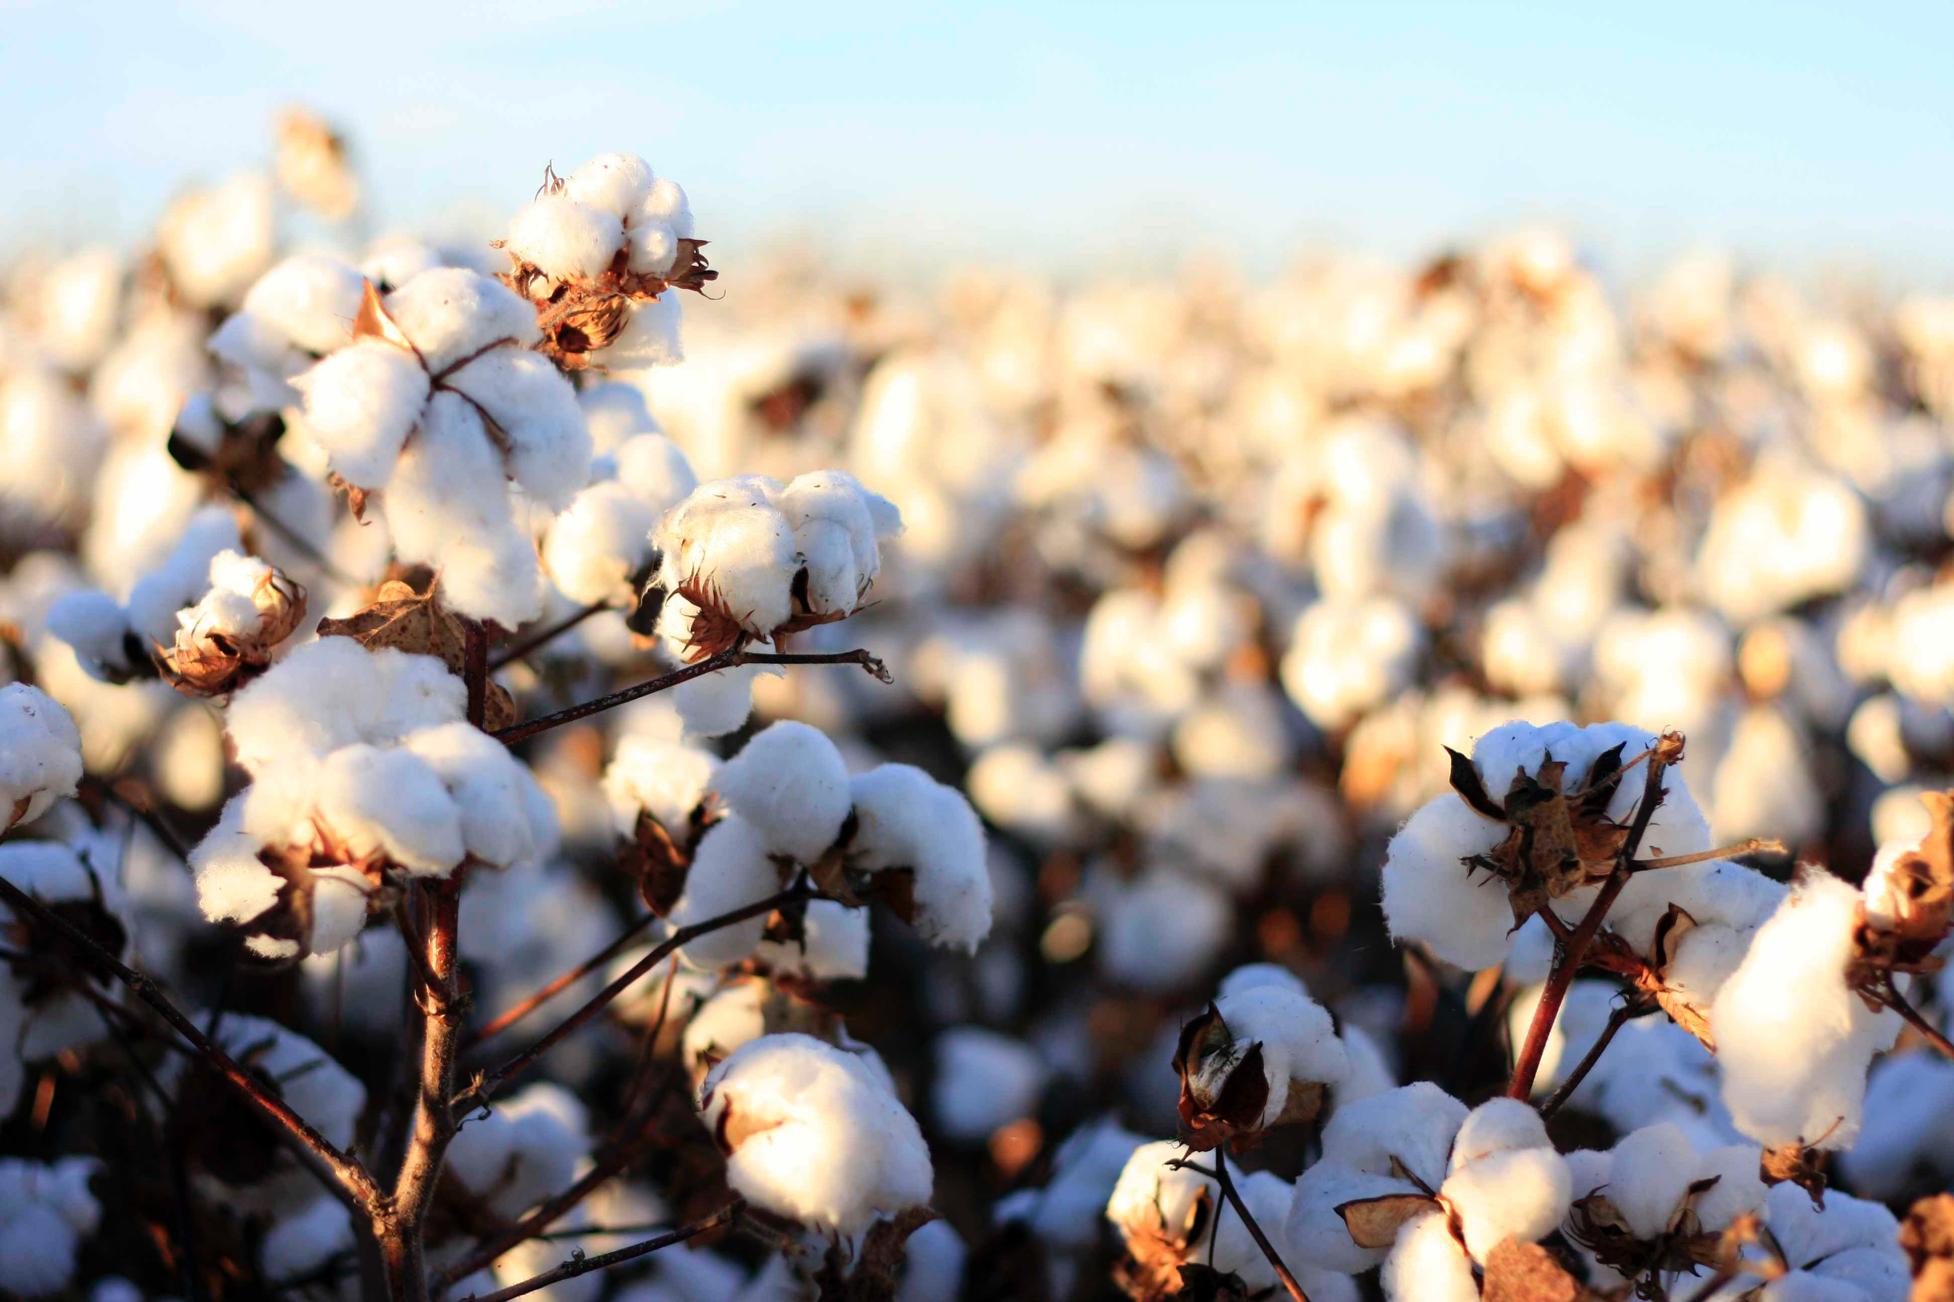
Responses to whole genome duplication in a plants
Simon Renny-Byfield

Slide 2


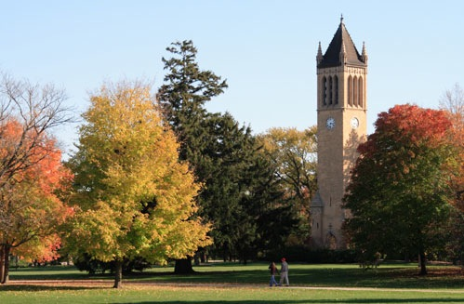



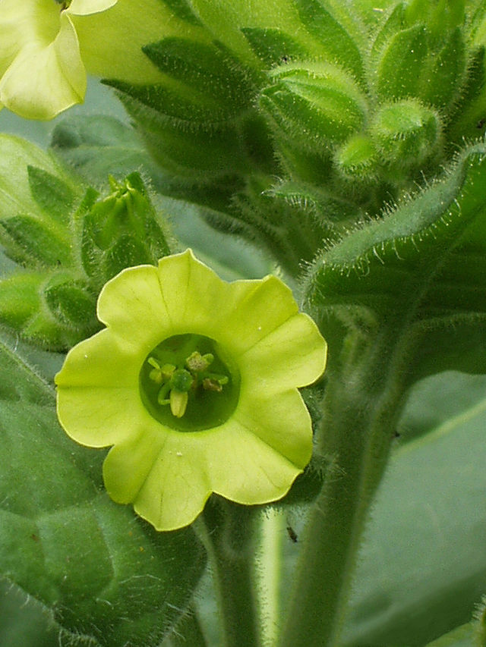

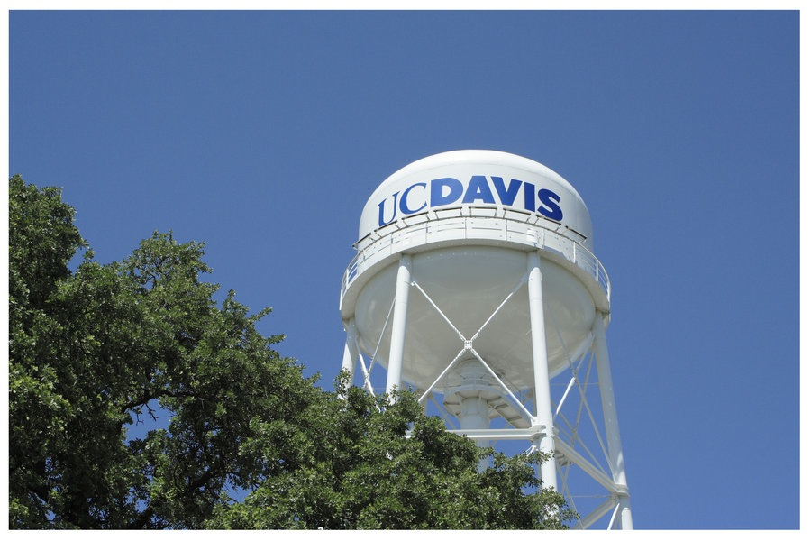
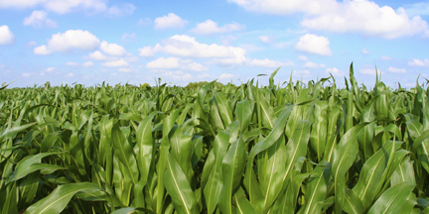
The Renny-Byfield World tour of England and America

Slide 3
outline
An intro to whole genome duplication (WGD)
WGD in the history of flowering plants
Gene network analysis following meso-WGD
Gene loss following ancient WGD

Slide 4
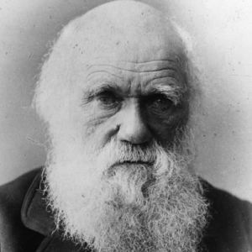
Darwin’s abominable mystery
“The rapid development, as far as we can judge, of all the higher plants within recent geological times is an abominable mystery.”

Slide 5
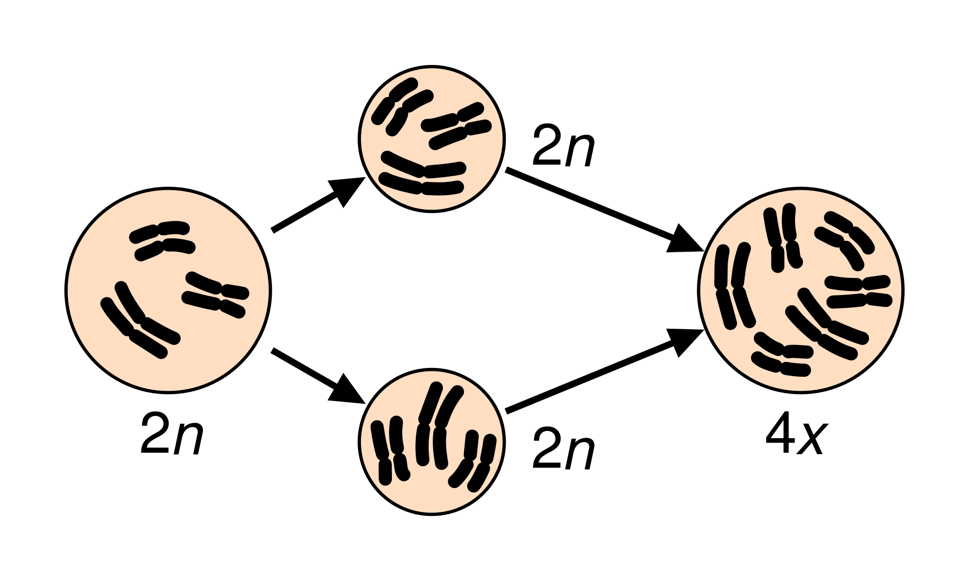
Whole Genome Duplication
Autopolyploidy
Allopolyploidy

Slide 6
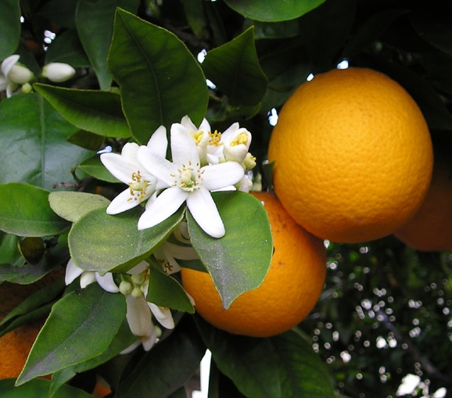
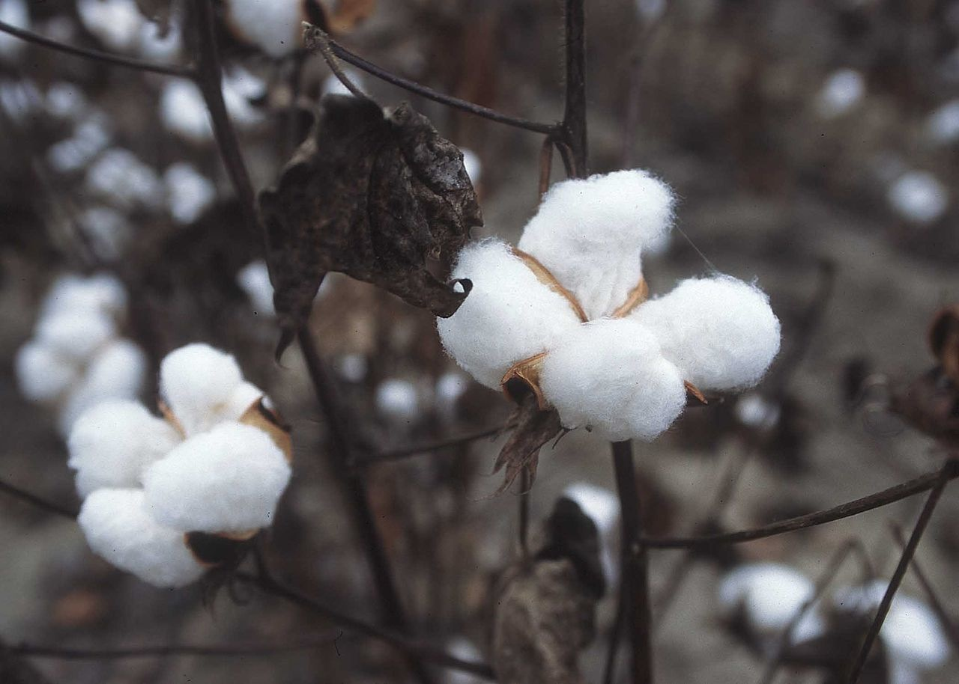
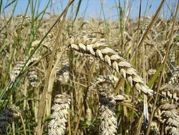
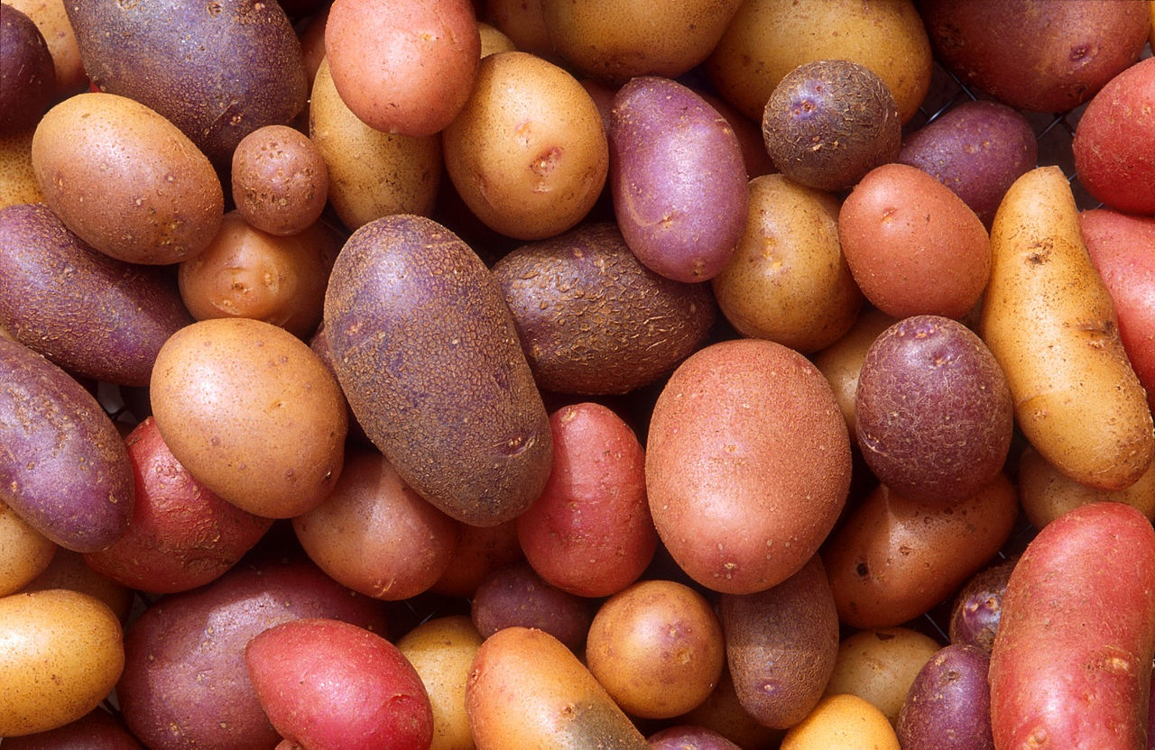
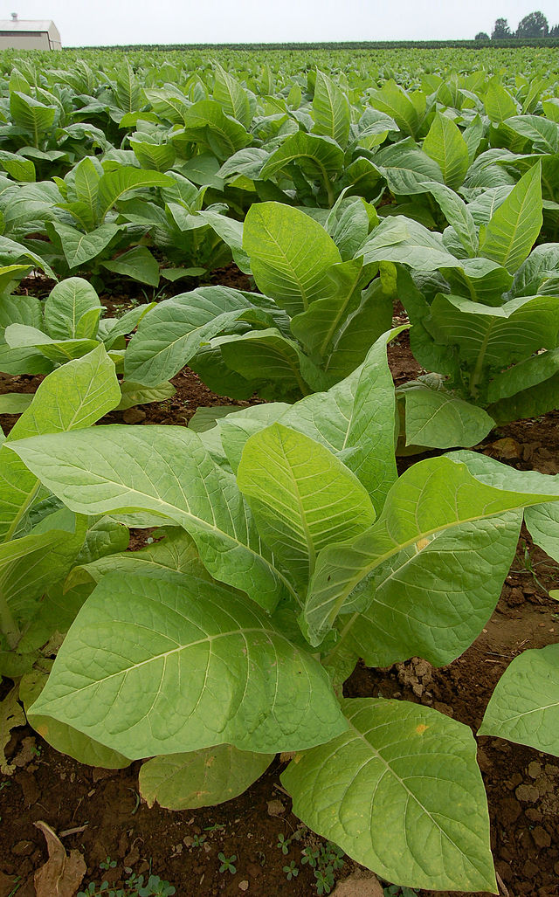
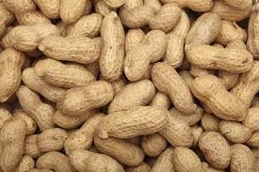
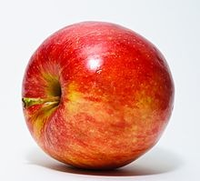
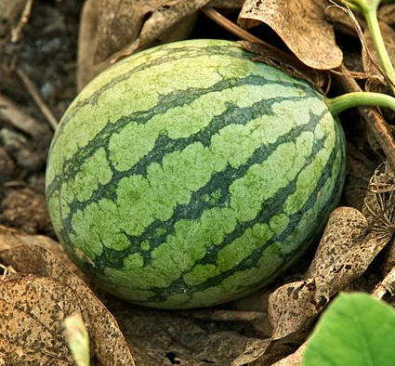
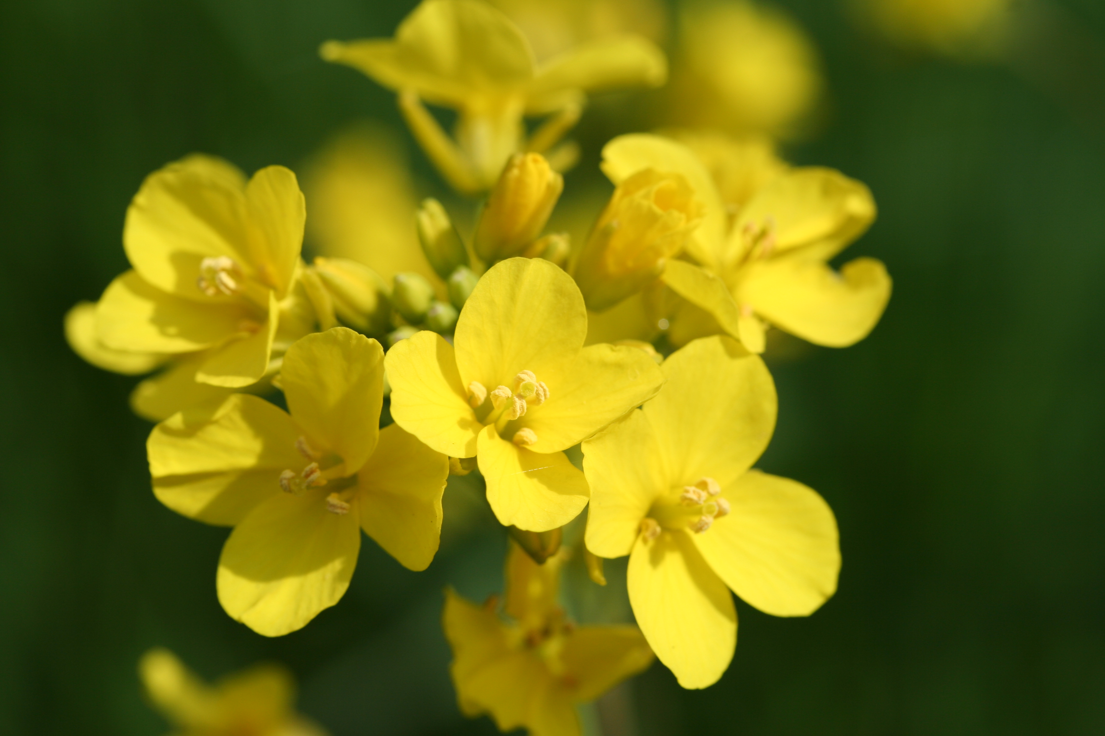
Polyploid crops

Slide 7
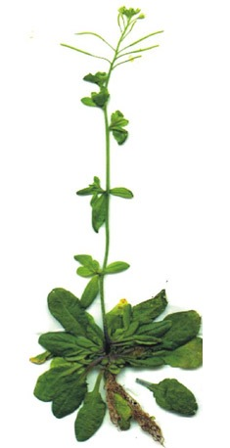
The dark secret of the angiosperms
Model “diploid” with n= 5
comparative genomics reveals α and β duplication events

Slide 8
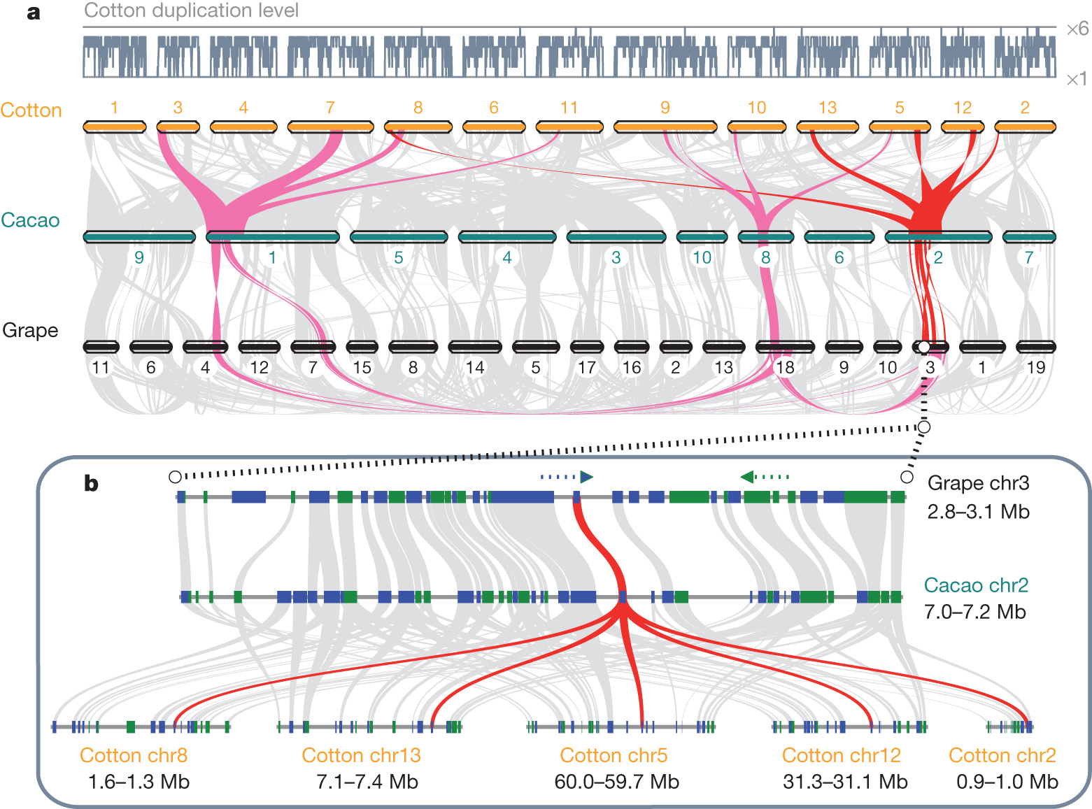
The dark secret of the angiosperms
Paterson et al., 2012 Nature
Schanble et al., 2011 PNAS

Slide 9
The dark secret of the angiosperms
Renny-Byfield and Wendel, American Journal of Botany, 2014

